Slide 1
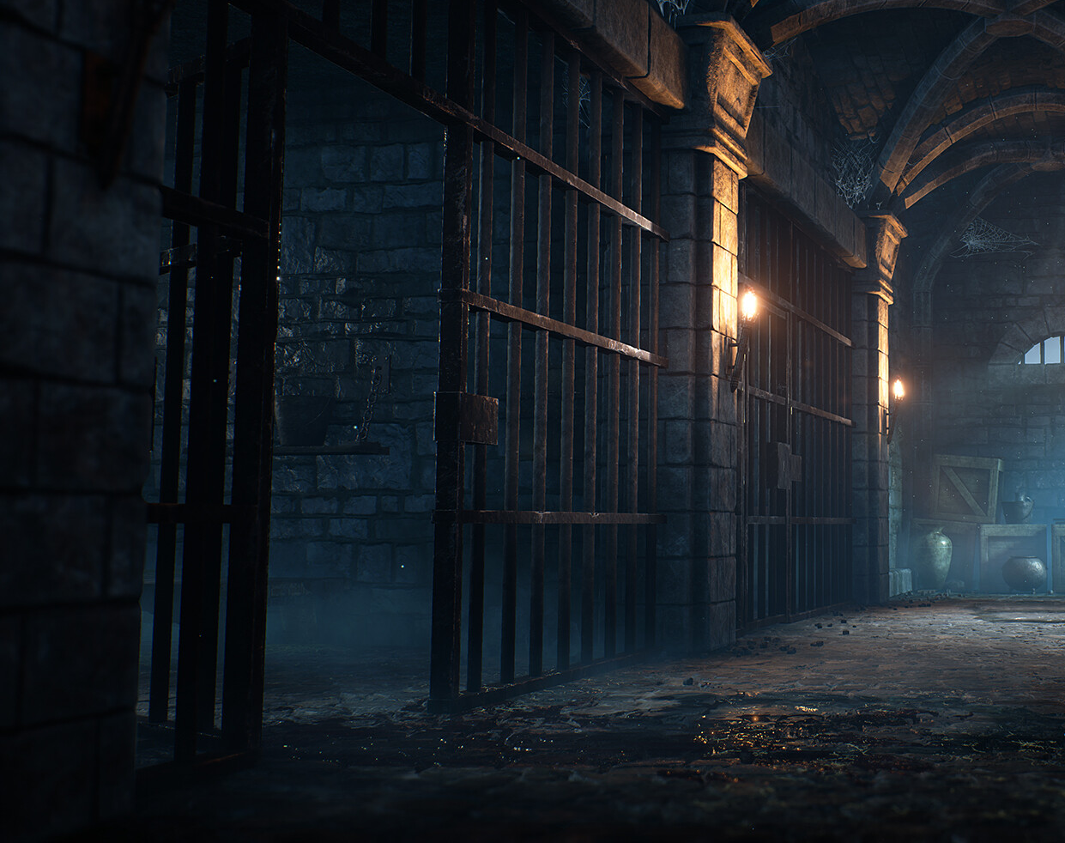
Winner Takes It All
Tomasz Wasilonek, 20210246
Vasco Correia, 50039633
Reference image taken from deviantart.com

Slide 2


Team
Vasco Correia
Tomasz Wasilonek

Slide 3
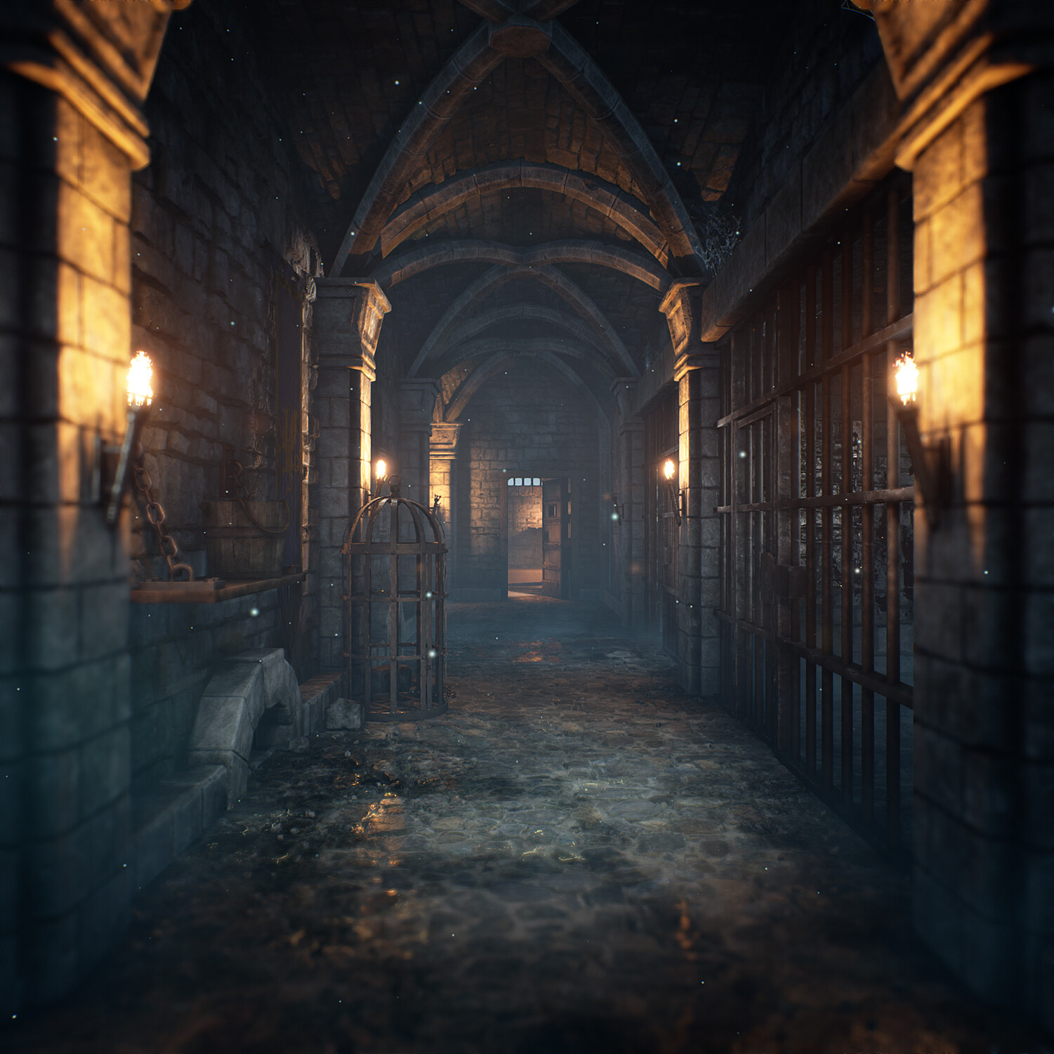
Overview
Windows PC
Multiplayer
2-4 players
Turn-based strategy game
Isometric birds view camera
Prison setting
Reference image taken from https://www.artstation.com/artwork/PmyDvn

Slide 4
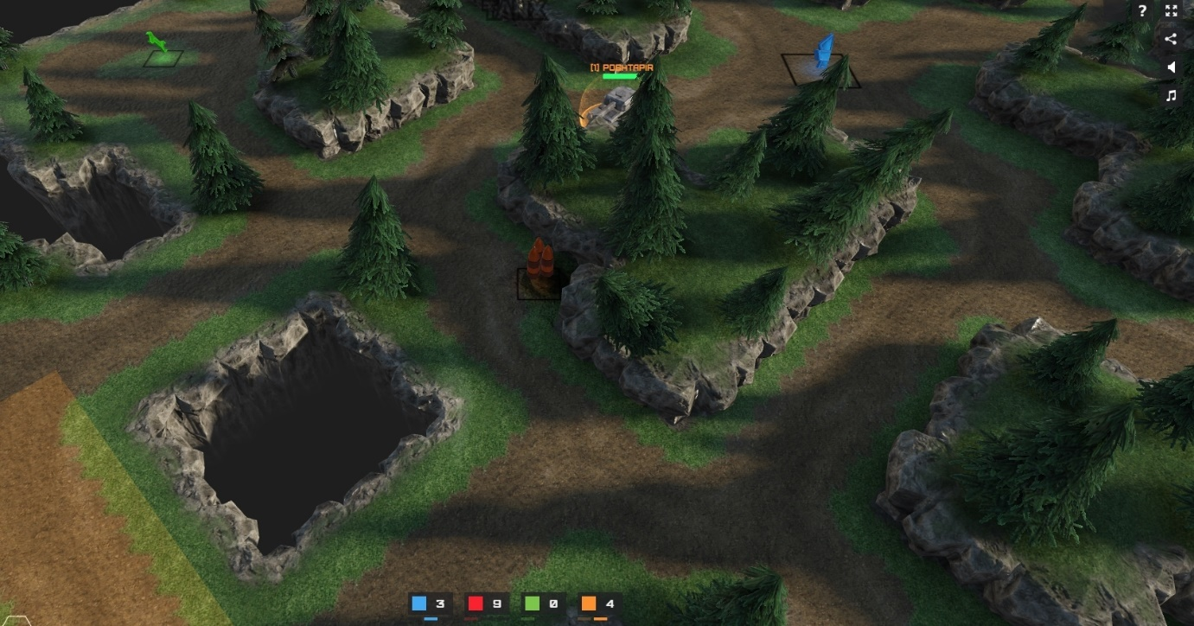
Level Design
Level will be made up of square tiles
5 different tiles: Normal, Obstacle, Elevated, Treasure and Trap.
Manually implemented
Reference image taken from https://tanx.io/

Slide 5
Gameplay Overview
Game runs in a loop
2 phases: Movement phase and combat phase
Collect loot and strategize positions
Last survivor wins
Movement phase
Combat phase

Slide 6
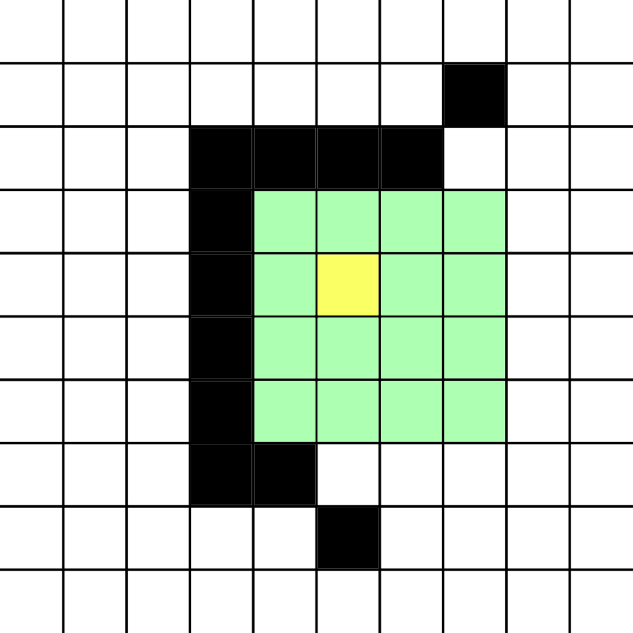
Movement phase
Use this phase to explore and collect loot
Players are limited by energy
1 tile = 1 energy
Lasts 10 seconds
Visual aid for tile movement

Slide 7
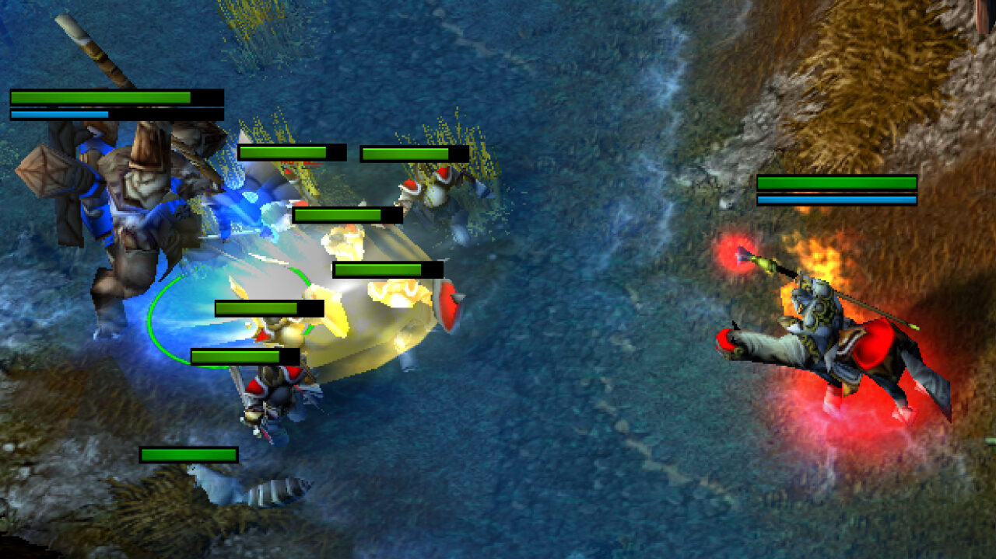
Combat phase
No movement allowed, used to fight
Can only fight if in line of sight
Can choose between different weapons to attack another player
Lasts 10 seconds
Reference image from Warcraft III

Slide 8

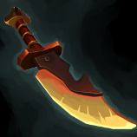


Weapons
Weapon | Damage | Range | Drop chance | Sprite
Club (default) | 1 HP | 1 tile | 0%
Knife | 3 HP | 1 tile | 50%
Throwable brick | 2 HP | 3 tiles | 25%
Hand Bomb | 3 HP | 2 tile | 25%

Slide 9
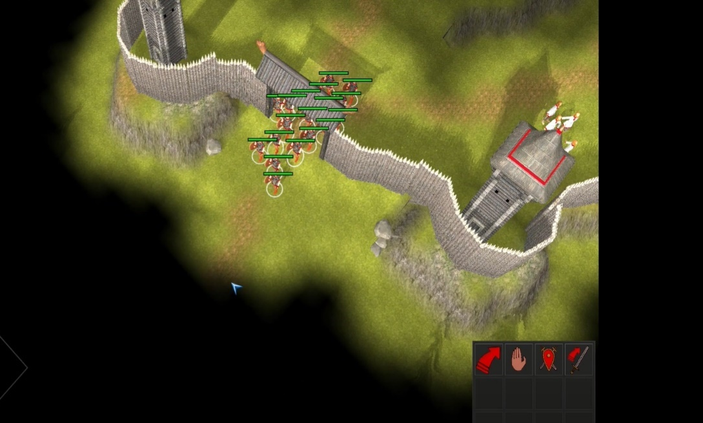
Fog of war
Explored tiles
Unexplored tiles
Visible tiles

Slide 10
Multiplayer logic and matchmaking server
Main game logic, keeping track of players, inventory etc.
Players
Game Servers
Player 1
Server 1
Matchmaking
Server
Player 2
Server 2
Initial connection,
Matching with available game servers
Managing Game servers (spawn new server, check for available slots for players)
Player 3
Store sessions
Server 3
Player 4
Server 4
In-memory datastore

Slide 11

Thank you for your attention!
Questions?

